Slide 1

ECM3420 CA
Visual Presentation
720091272

Slide 2
1.
Research Question
Dataset Introduction
2.
3.
Machine Learning (ML) Technique
4.
ML Models Employed
Data Analysis and Results
5.
Concluding Remarks
6.
7.
Limitations of Data and Methods

Slide 3
"Can we accurately predict customer churn and fine tune it using a decision tree model?".
Why should you care?
Churn rate is critical for management and financial strategy
Customer acquisition in general considered 5x more expensive than customer retention across organisations (Hart et al. 1990)
Developing a model to predict churn based on existing features helps provide a structural backbone for strategy and reduce need for acquisition and subsequent losses
Notes:
The research question is can we accurately predict customer churn and fine tune using a decision tree model?
You should care about this as customer acquisition is at minimum 5x more expensive than retention, leading to customer loss being a critical datapoint for financial management. Developing a model to predict customer loss and analysing the dataset will provide a foundation for strategy, and pinpoint particular metrics associated with loss

Slide 4
1.
Research Question
Dataset Introduction
2.
3.
Machine Learning (ML) Technique
4.
ML Models Employed
Data Analysis and Results
5.
Concluding Remarks
6.
7.
Limitations of Data and Methods

Slide 5
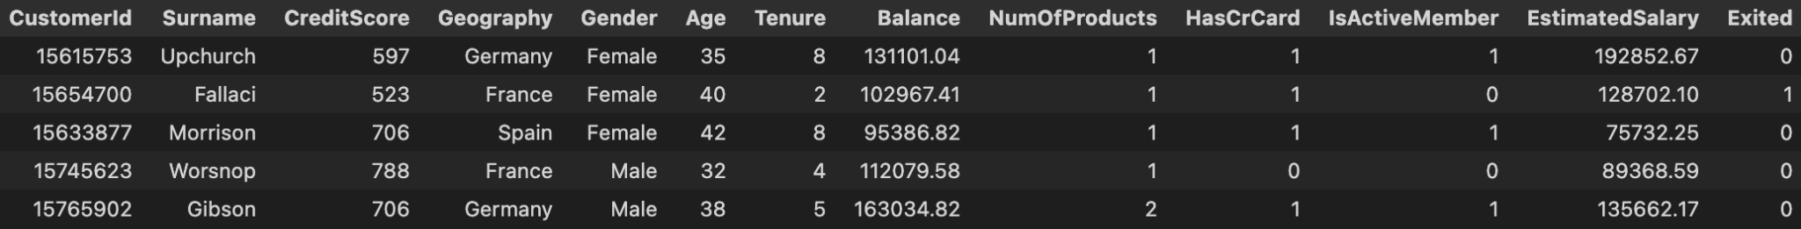
Banking Dataset (~10,000 rows of data, 11 features) Kaggle: [2]
Categorical and Numerical data
Contains Customer Information
Bank Management Data Storage
Notes:
The dataset is a banking dataset found on kaggle, comprised of 10,000 rows and 11 features with a mix of categorical and numerical customer data, one of which being the binary target Exited.

Slide 6
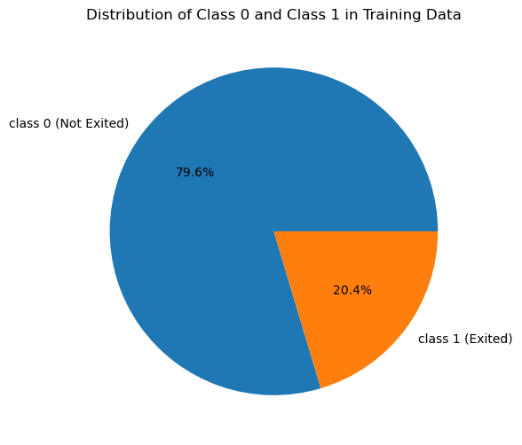
Heavily Imbalanced dataset for target (Exited)
Why is this an issue?
minority class
lower precision/recall than the majority class.
Accuracy weighted to majority class compared to minority,
difficult for classifier to perform well on the minority class
(Guo et al. 2008)
Notes:
From this graph we can see 80% of the dataset is comprised of class 0, which is not exited, and 20% class 1 which is exited. This makes the dataset imbalanced, which is an issue because the model can perform worse on the minority class and accuracy will be weighted toward the majority class making necessary to use additional metrics to assess the model

Slide 7
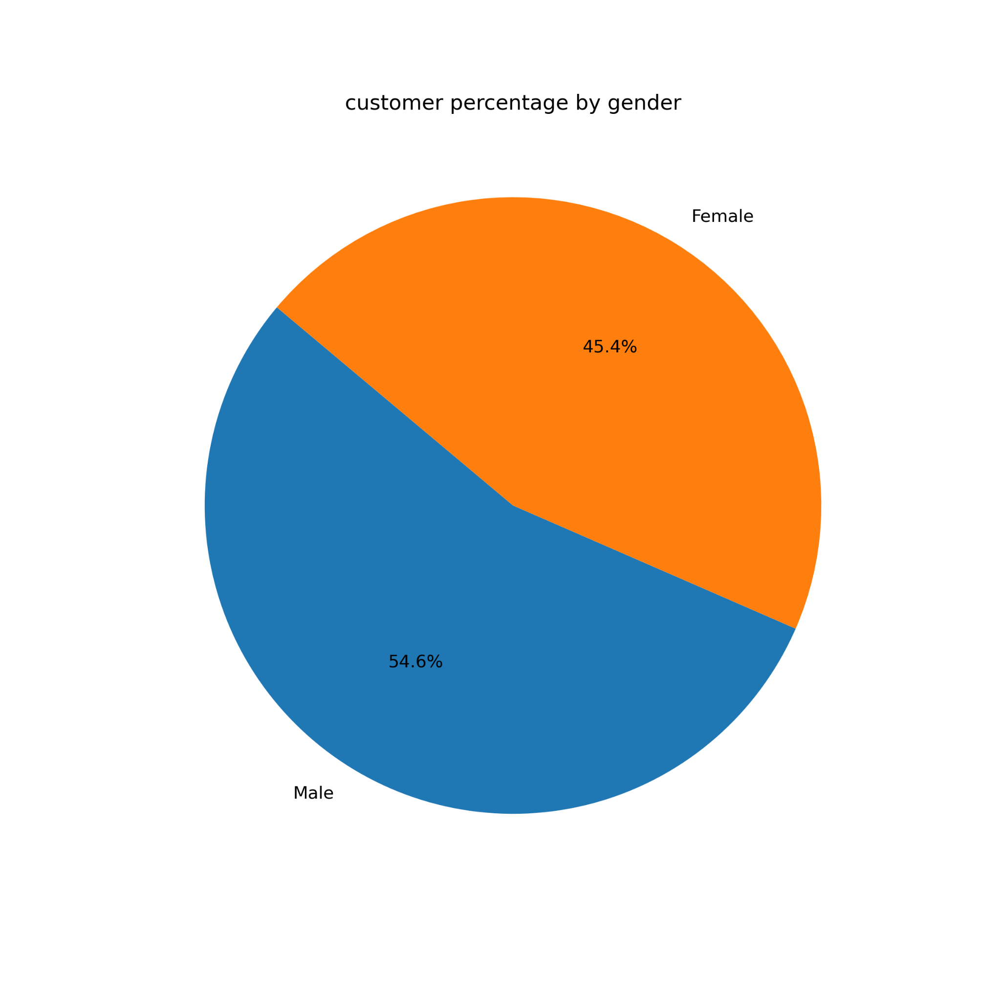
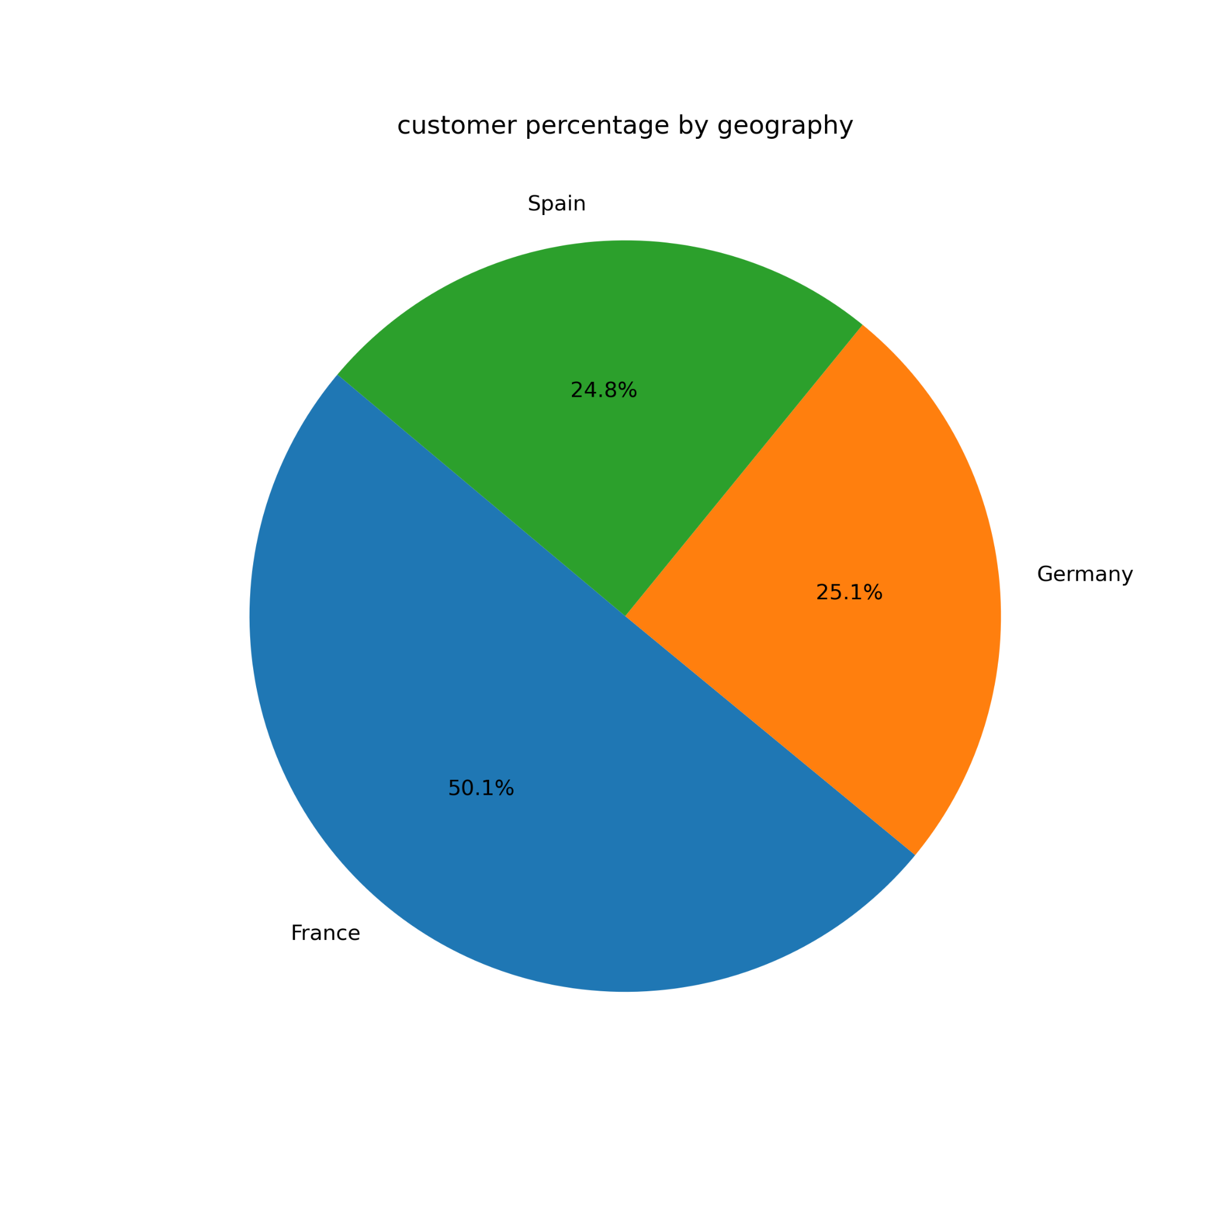
Dataset stats - Gender and Geography of Customers
Gender is relatively even, with males slightly higher percentage
½ of customers originate from France
Germany and spain ~¼ each
Notes:
from these graphs we can see that there are 10% more male customers, and 50% from france with the remaining quarters being from Spain and Germany

Slide 8
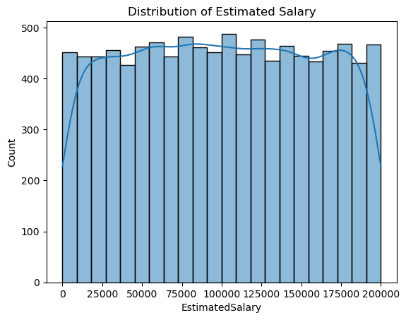
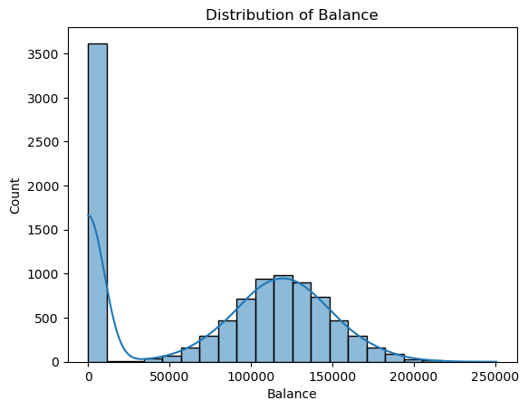
Dataset stats - Distribution
Balance has normal distribution with a spike at 0, likely representing customers with new accounts or inactive accounts
Nearly even distribution of salary counts between customers

Slide 9
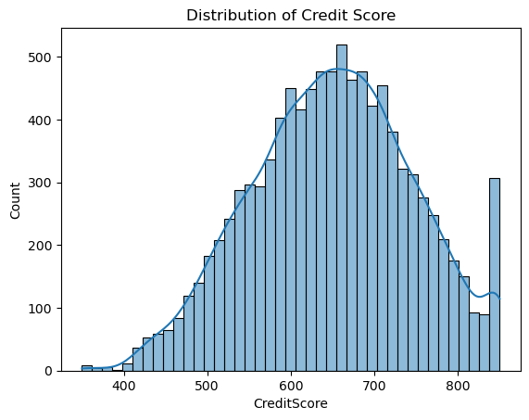
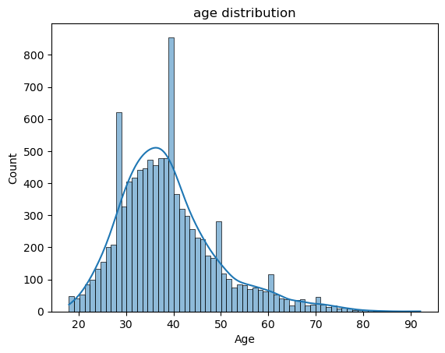
Dataset stats - Distribution
Peak at 40 years
Skewed to have younger customers
Normal Distribution
Spike at 800+ credit score

Slide 10
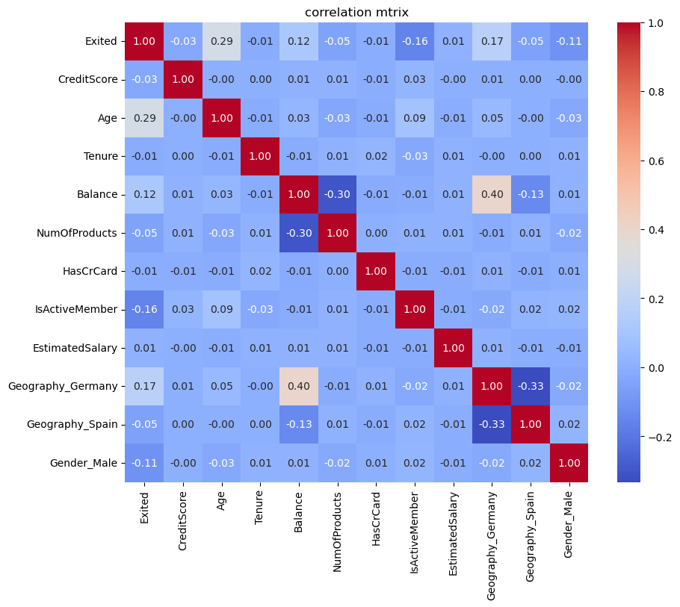
Strongest correlations with Exited
Age (0.29)
Geography (0.17, 0.5)
IsActiveMember (-0.16)
Balance (0.12)
Correlations are mostly weak
Younger members, active members, and lower balance customers are more likely to stay

Slide 11
1.
Research Question
Dataset Introduction
2.
3.
Machine Learning (ML) Technique
4.
ML Models Employed
Data Analysis and Results
5.
Concluding Remarks
6.
7.
Limitations of Data and Methods

Slide 12
Classification
Supervised Learning
Target: Exited
0 = customer retained
1 = customer left
Use of labeled data to facilitate learning of model to generalise against unlabeled “unseen” data
(Cunningham et al. 2008)
Notes:
the main technique is classification, due to the target exited being binary. I also use supervised learning, which is the use of labeled data in training such that it can generalise against unseen (unlabeled) data in testing.

Slide 13
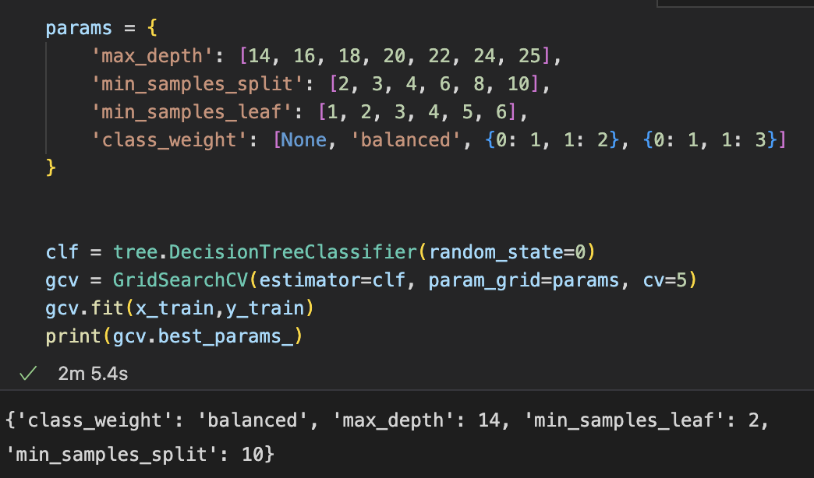
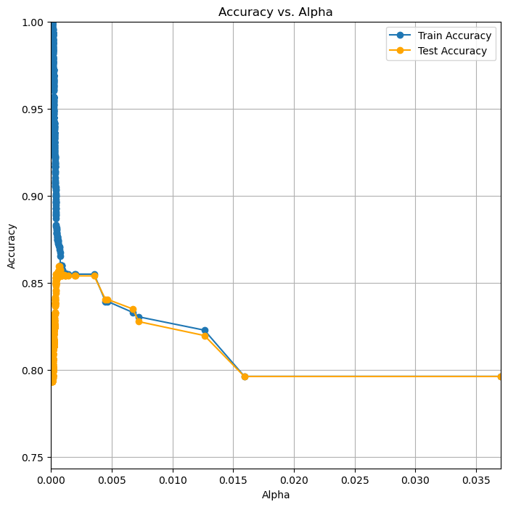
4 Trials
Baseline
Dropped Feature
Baseline + ROS
Baseline + SMOTE
with 3 configurations each
Baseline
GridSearchCV
GridSearchCV + Cost Complexity Pruning (Alpha)

Slide 14
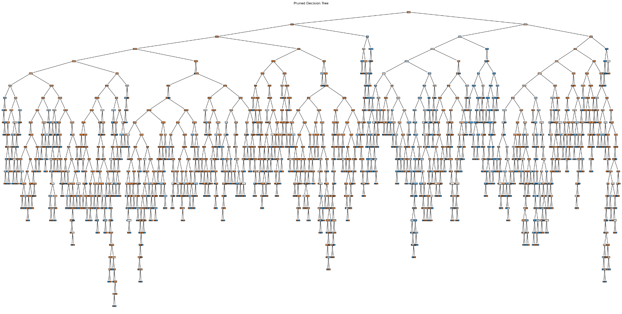
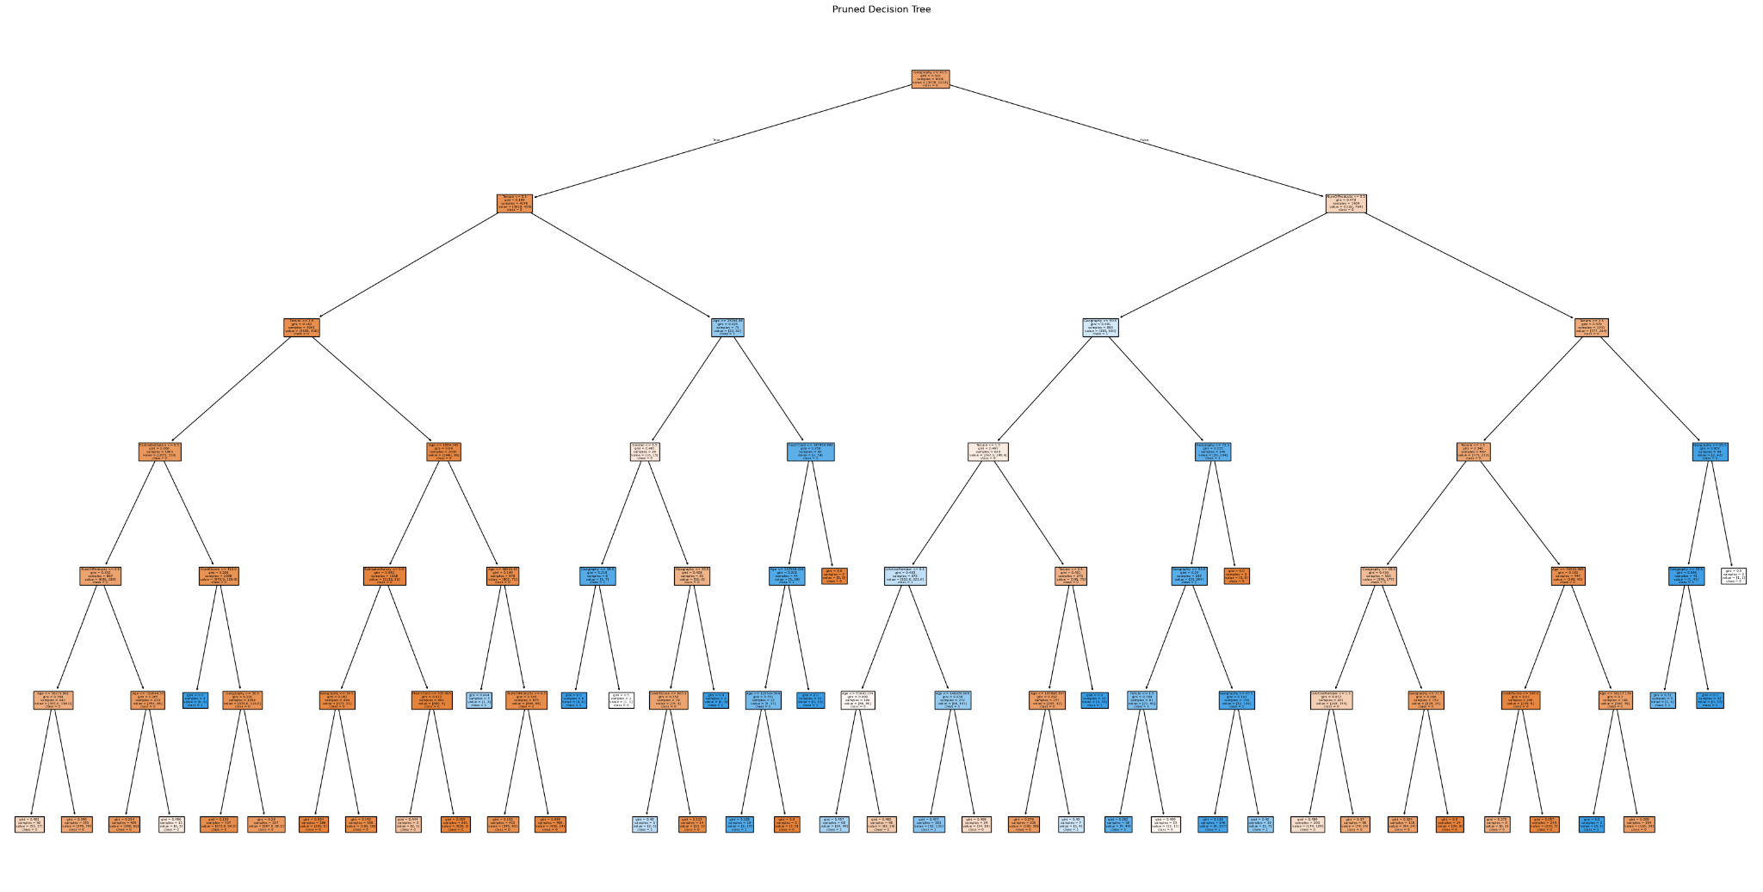
Cost-complexity pruning is a technique to reduce the size of a tree, which lowers its complexity
Reduces overfitting
Cost Function:
Rα(T) = R(T) + α · |Leaves(T)|
Cost complexity of tree T = training error of T + ccp parameter * leaves
(Ravi et al. 2017)
(Friedman et al. 2009)
GCV (Grid Search Cross-Validation) is a tool to tune hyperparameters and model selection for machine learning models (Yan et al. 2022)
In this case used for
max_depth
min_samples_split
min_samples_leaf
class_weight
Pruning of no dropped features run:

Slide 15
SMOTE
Synthetic Minority Over-sampling Technique (SMOTE)
Oversampling approach
Synthetic minority class samples
(Blagus et al. 2013)
RandomOverSampler
Oversampling approach
Randomly duplicate the instances of minority classes to balance the datasets.
(Benala et al. 2023)

Slide 16
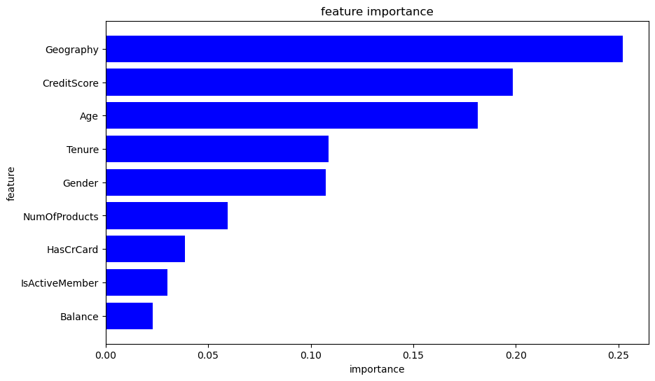
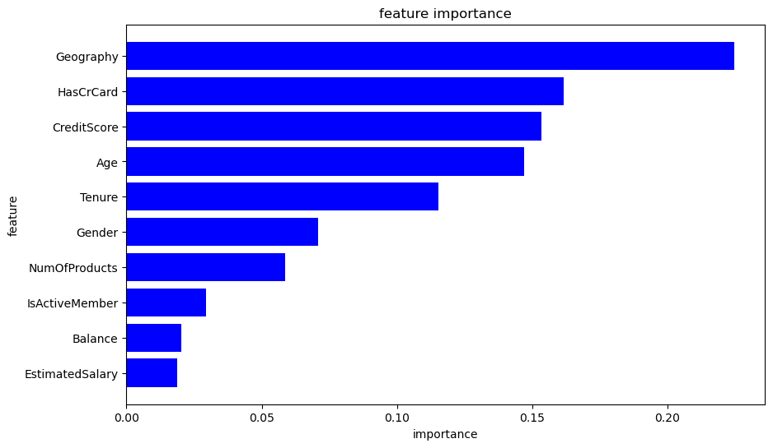
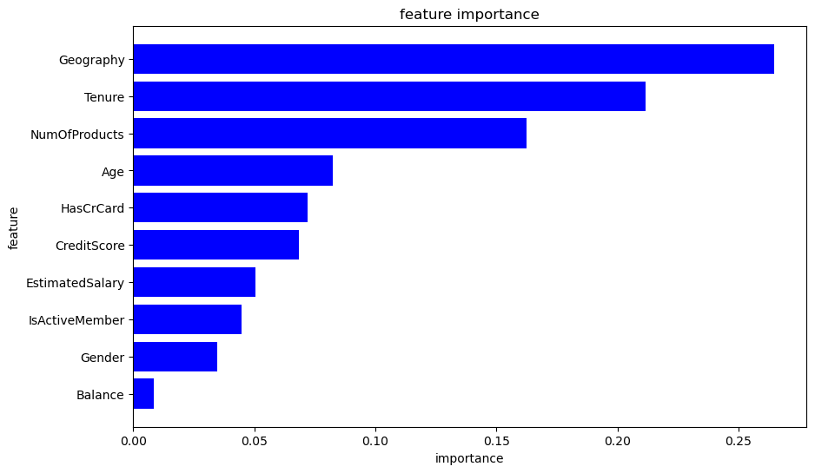
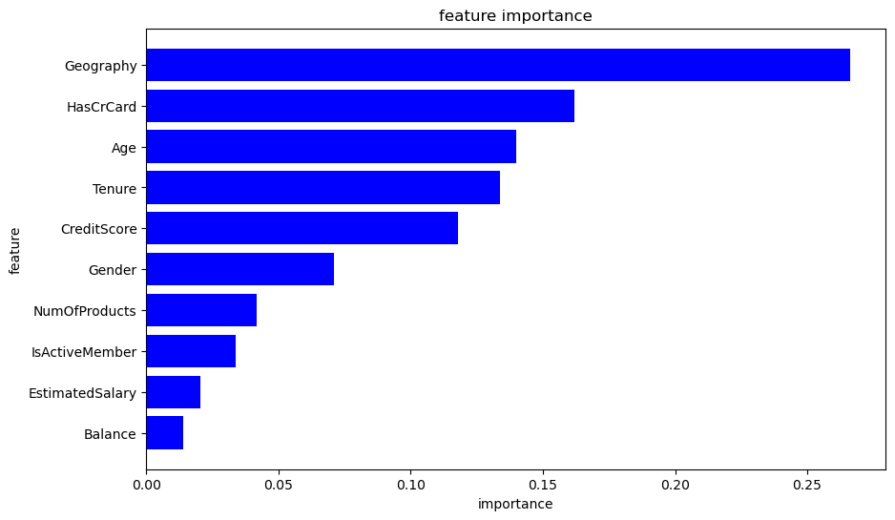
Geography most important feature in all 4
CreditScore and Age consistently top 4
Categorical features appear most important
Balance lowest average importance
1 Feature Dropped
Undropped
Undropped + SMOTE
Undropped + ROS
Notes:
in the feature importance graph across all 4 models we can see Geography as most important, while balance appears to be lowest.

Slide 17
1.
Research Question
Dataset Introduction
2.
3.
Machine Learning (ML) Technique
4.
ML Models Employed
Data Analysis and Results
5.
Concluding Remarks
6.
7.
Limitations of Data and Methods

Slide 18
DecisionTreeClassification
Decision trees are tree models that classify instances by sorting them beginning from the root node based on feature values.
Node = a feature in an instance to be classified,
Branch = a value that the node can assume.
(Kotsiantis et al. 2007)
Why use Decision Trees?
Dataset has categorical and numerical data
DTs work with numerical and categorical data directly,
linear classifiers or neural networks cannot
Data is transformed using label encoder but only for consistency across oversampling techniques
Don’t need to scale data
(Günlük et al. 2021)
DT’s are strong at handling nonlinear relationships (Alshammari et al. 2024)
Notes:
I use a decision tree for all 4 models, which classifies instances by sorting them from the root node based on feature vales, where a node is a feature and a branch is a value that the node can assume.
I chose this model as they work with both categorical and numerical data which are present in the dataset. Also, data does not need to be scaled as decision trees are strong at handling nonlinear relationships

Slide 19
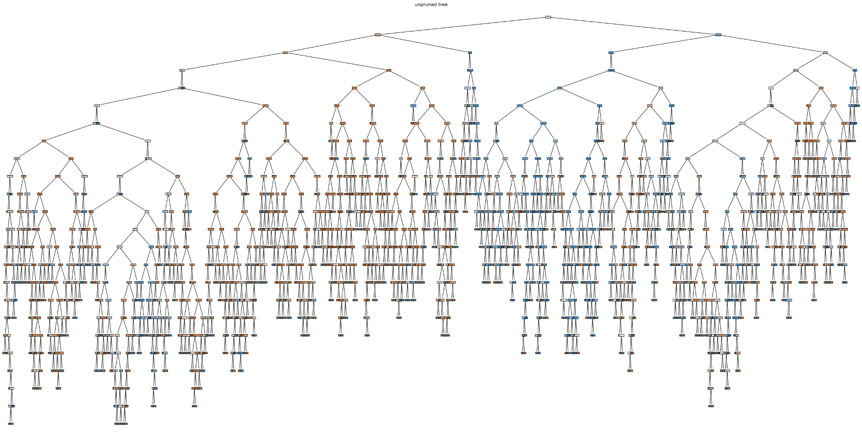
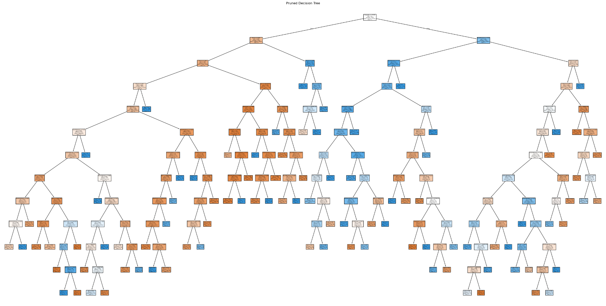
DecisionTreeClassification
Pruning of SMOTE run:

Slide 20
1.
Research Question
Dataset Introduction
2.
3.
Machine Learning (ML) Technique
4.
ML Models Employed
Data Analysis and Results
5.
Concluding Remarks
6.
7.
Limitations of Data and Methods

Slide 21
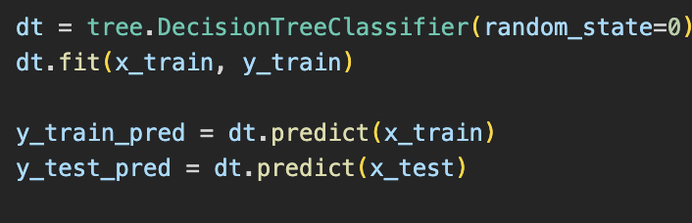
Precursor Information
Categorical Features: Geography and Gender
Transformed using LabelEncoder
Notes:
all models use train test split of 0.4 and random state of 0 to seed each run and categorical features Geography and Gender are transformed with a label encoder.

Slide 22
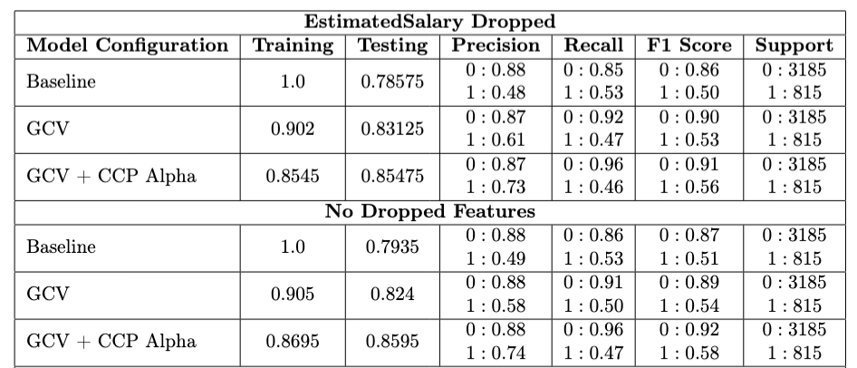
Results
Similar Results between Dropped and Undropped
Marginal difference in accuracy
Recall slightly higher against minority class in no dropped features
Precision slightly higher against minority class in dropped features
Models will gradually overfit less as more optimisation tuning is incorporated
Poor performance for both on the minority class

Slide 23
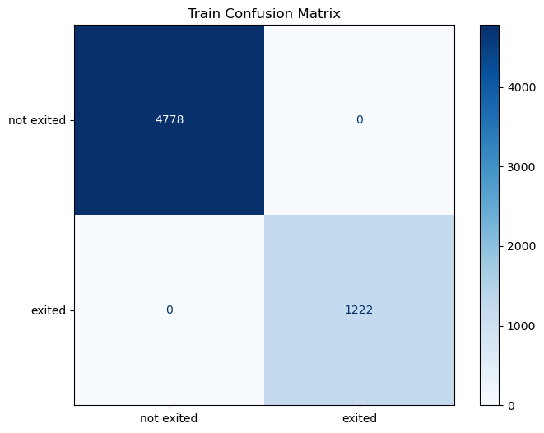
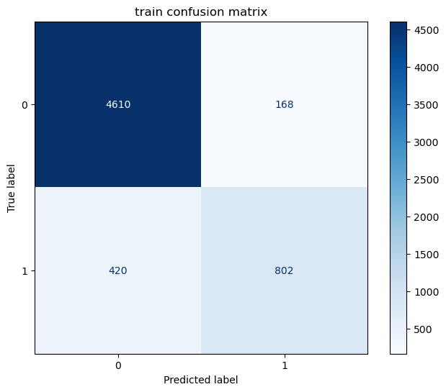
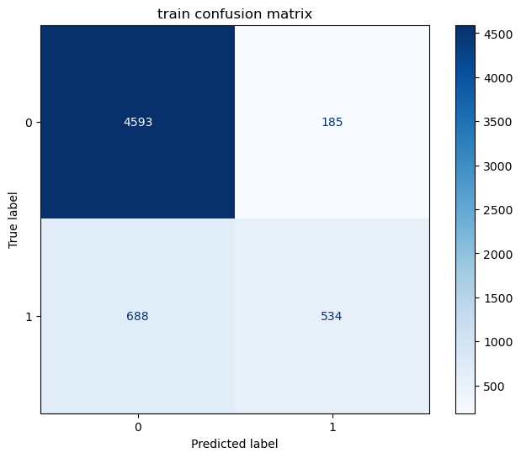
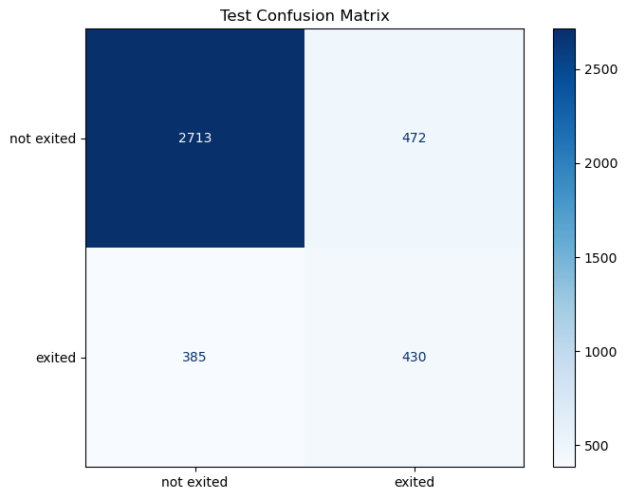
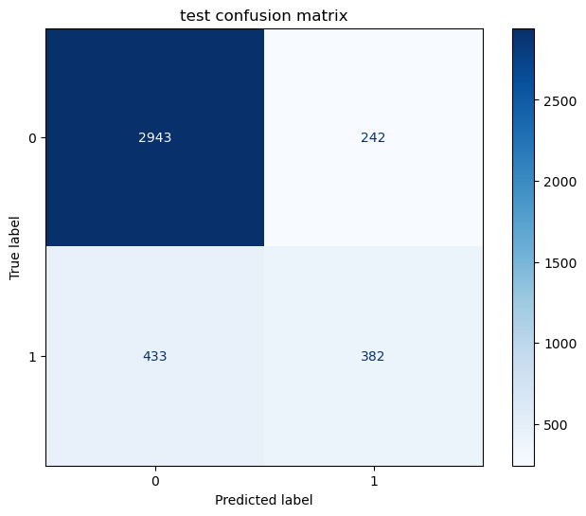

Dropped Feature: EstimatedSalary
No Change
GCV
GCV+ccp_alpha
Low training accuracy on the minority class
Low testing accuracy on the minority class

Slide 24
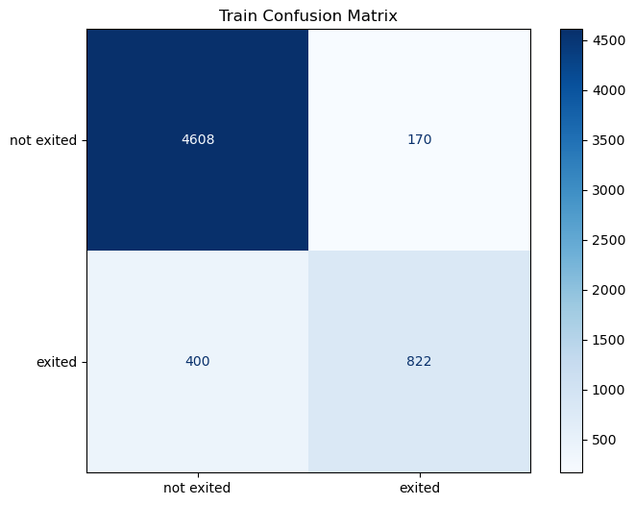




No Dropped Features
No Change
GCV
GCV+ccp_alpha
Marginal difference to dropped feature model
Low training accuracy on the minority class
Low testing accuracy on the minority class

Slide 25
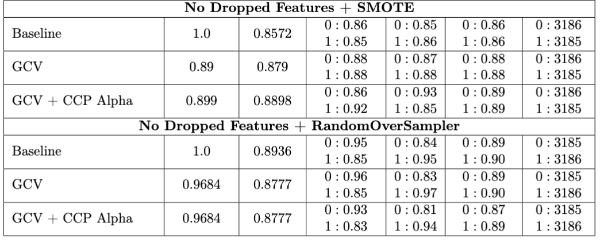
Accuracies are very similar, with ROS having a stronger accuracy at baseline
ROS has slightly higher f1 score
ROS is overfitting the data in all 3 configurations
SMOTE gradually overfits less as more optimisation tuning is added

Slide 26
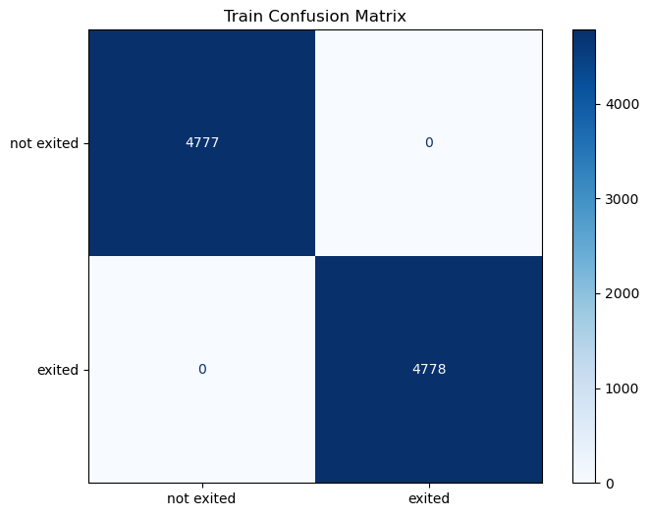

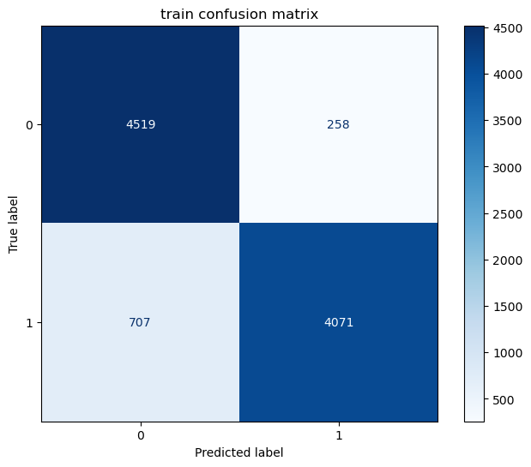
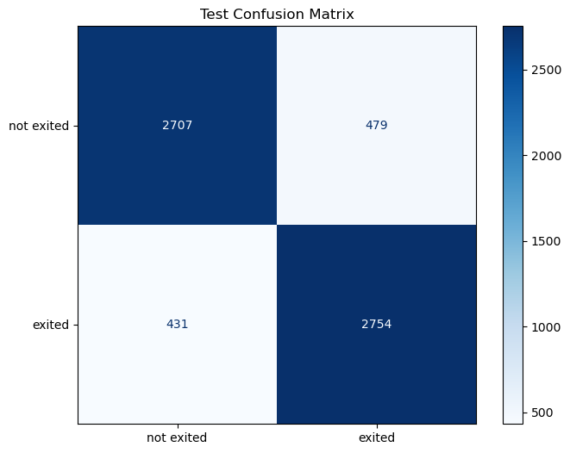


SMOTE
No Change
GCV
GCV+ccp_alpha
High training accuracy, lowers slightly in minority class for gcv+alpha: less overfitting
Training and Test accuracy similar across the board
Notes:
In the confusion matrices for SMOTE, it is performing well on the majority and minority classes for both training and testing, with a slight drop on the minority class after using GCV+Cost Complexity Pruning, despite the accuracy increase

Slide 27

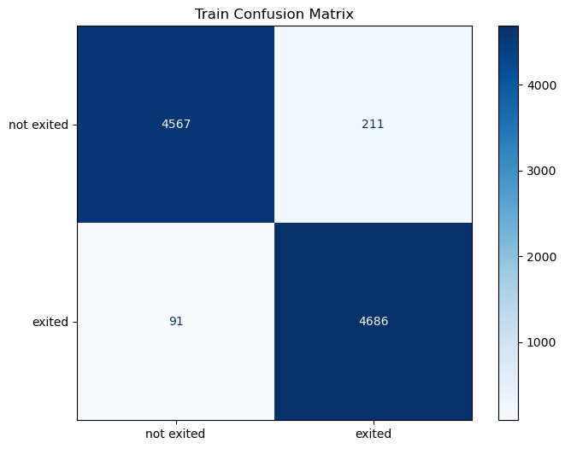
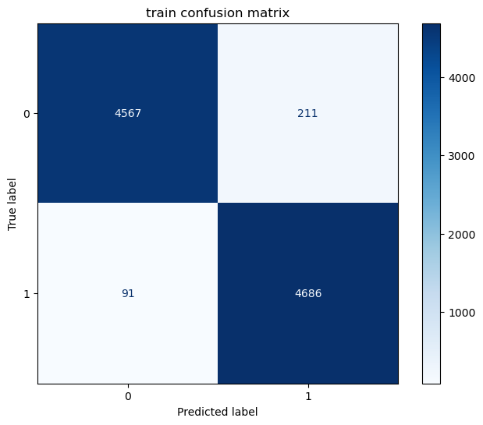
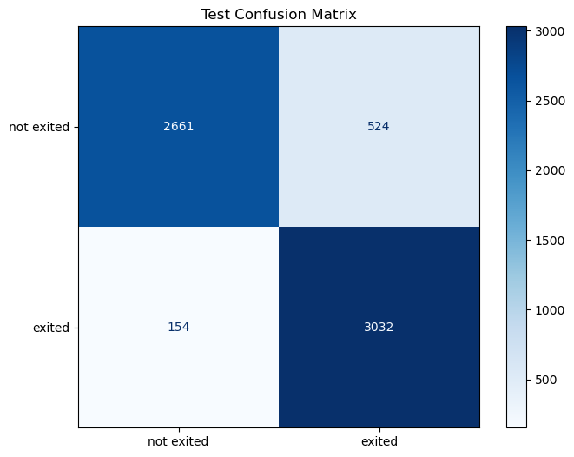
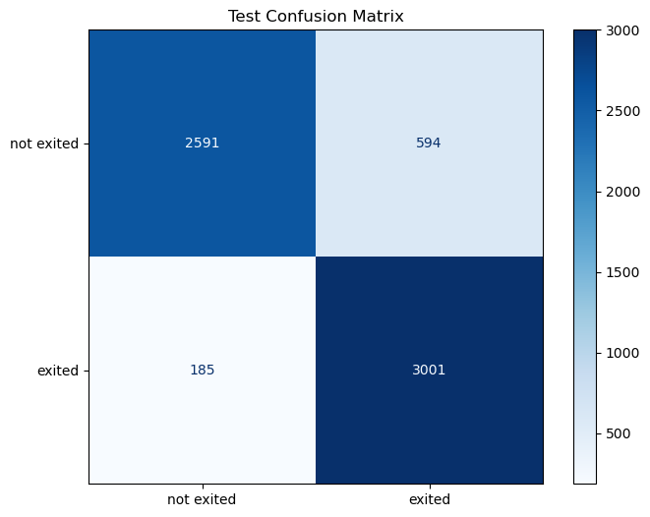
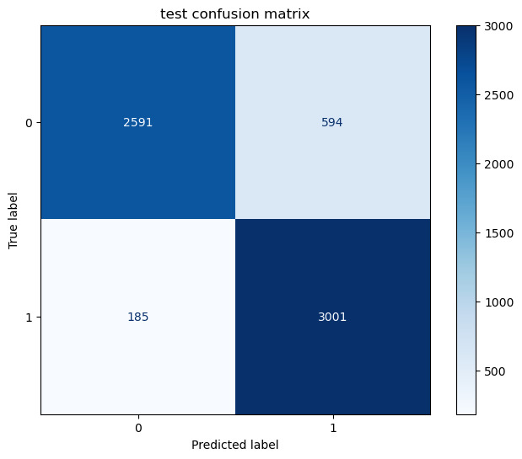
ROS
No Change
GCV
GCV+ccp_alpha
Lower testing accuracy on the majority class
High testing accuracy on the minority class
High training accuracy across, potentially overfitting
Notes:
ROS has a lower testing accuracy on majority class in the compared to in training and there is a high training accuracy across all 3 configurations pointing again to an overfitting issue. SMOTE has a better performance on the majority class testing set while ROS performs better on the minority class after GCV+CCP alpha though it sacrifices the majority class performance

Slide 28
1.
Research Question
Dataset Introduction
2.
3.
Machine Learning (ML) Technique
4.
ML Models Employed
Data Analysis and Results
5.
Concluding Remarks
6.
7.
Limitations of Data and Methods

Slide 29
Summary
- Dropping even a single feature that was least important and lowest correlated with Exited, had no marginal effect on performance
Model poor performance when data was left imbalanced on minority class
Oversampling techniques marginally improve accuracy by 2-3% at most tunings
Oversampling techniques drastically improve performance on minority class
RandomOverSampler (ROS) had good accuracy but tended to overfit the data
SMOTE had good accuracy, slightly less that ROS, but did not overfit the data once tuned with GCV + ccp_alpha
All models saw 2-3% increase in performance when tuned with GridSearch CV
All models saw 2-3% increase in performance when tuned with Cost Complexity Pruning alpha, with the exception of ROS which saw a 2% decrease
Notes:
dropping unimportant features did not have a large affect on performance, model had poor performance on minority class when data was imbalanced, oversampling techniques fixed this, but ROS would overfit the training data, leading to SMOTE being the standout option to solve imbalance issues (better performance without the drawback of overfitting). Finally, all models increased with GCV and CCP with the exception of ROS which decreased by 2%

Slide 30
1.
Research Question
Dataset Introduction
2.
3.
Machine Learning (ML) Technique
4.
ML Models Employed
Data Analysis and Results
5.
Concluding Remarks
6.
7.
Limitations of Data and Methods

Slide 31
Imbalanced dataset
Oversampling
RandomOverSampling
Random on existing data
SMOTE
“Synthetic”
Generated samples may be unrealistic, not as reliable as real data
Notes:
The limitation of the dataset is the imbalanced classes which inhibits the performance on the minority class prior to oversampling as shown in the results section.
Oversampling techniques did fix this, though RandomOverSampler which creates random duplicates of existing data, and SMOTE which creates artificial samples based on existing data can make unrealistic improvements particularly when considering the real-world application of these models on imbalanced datasets where this may distract from actual pattern recognition.

Slide 32
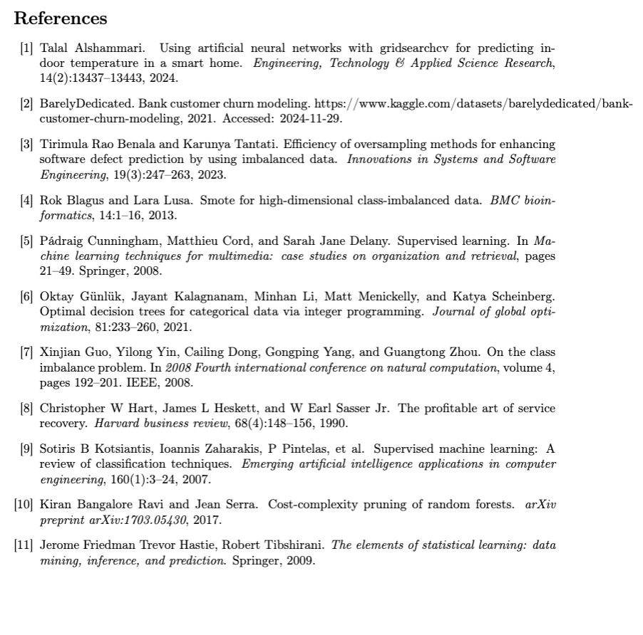
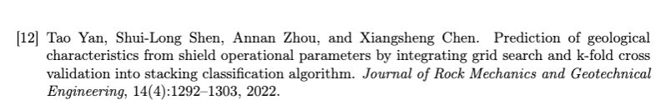
Bibliography

